Slide 1
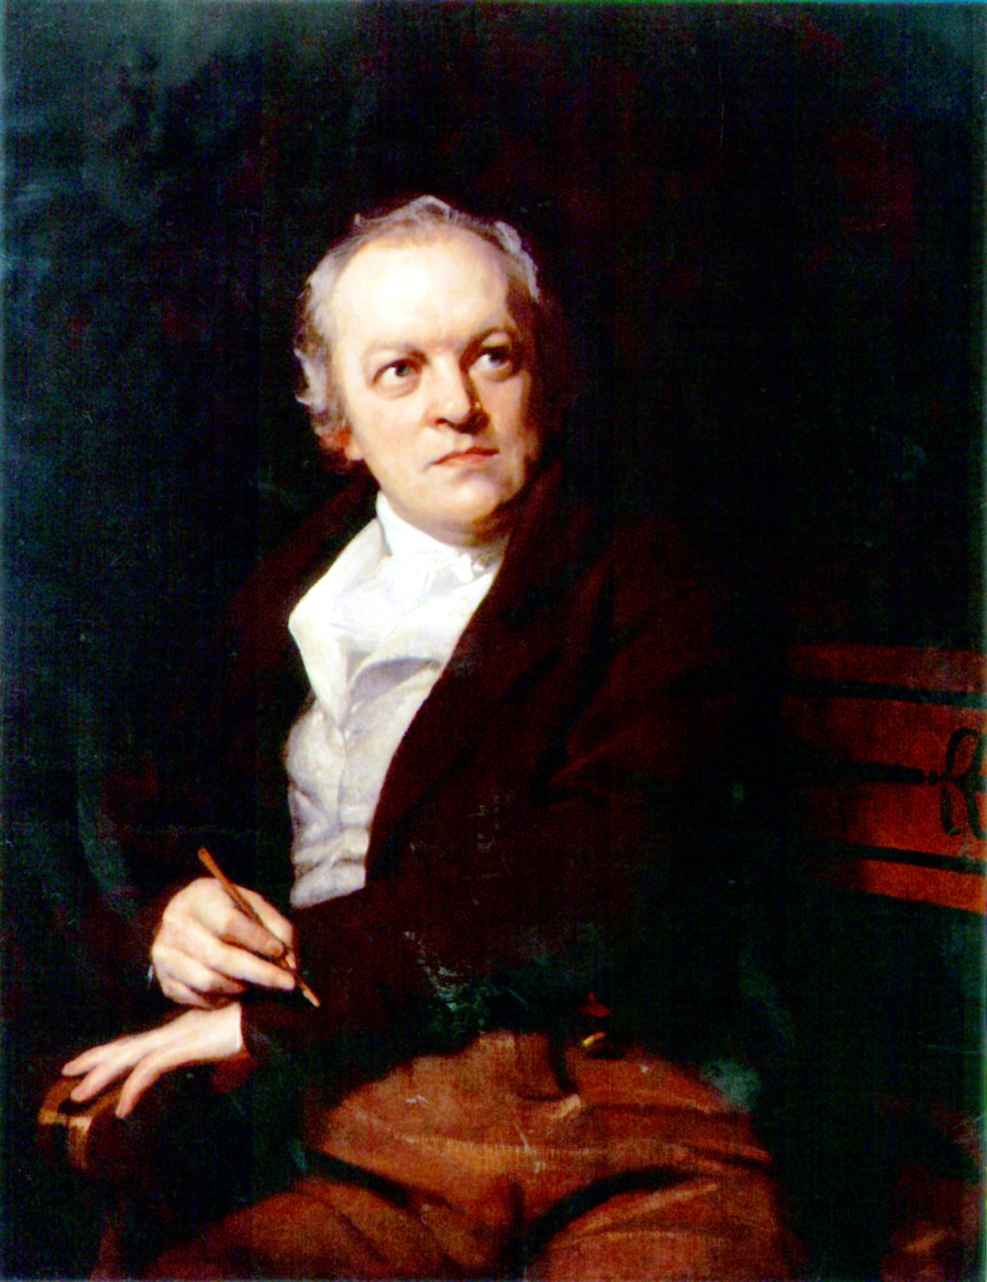
William Blake
1757-1827
Mad man or spiritual visionary?

Slide 2
His Life
Born 1757 in London
Age 4 saw Ezekiel in tree surrounded with other angels
Apprenticed to an engraver at age 14 which allowed him to make a living.

Slide 3
Growing up
His father was a hosier and could only afford the minimal of reading and writing.
Attended and art school
His father tutored him until age 14

Slide 4
His life
He was apprenticed until he turned 21
Married four years later
Wife was barren
Tried to hire a concubine (for Children)

Slide 5
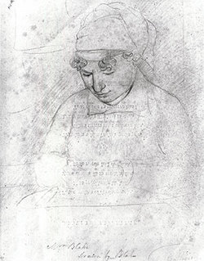
His wife Catherine Boucher
Catherine was a plain woman
She was unlearned
Helped with the
writing and
art work.

Slide 6
Contraries or Opposites
Blake is known for using contraries to get his point across.
He wrote Proverbs like, “You never know what is enough, until you know what is too much”
He wrote SONGS OF INNOCENCE and SONGS OF EXPERIENCE to illustrate those differences

Slide 7
From Songs of Innocence
To see a World in a Grain of Sand And a Heaven in a Wild Flower, Hold Infinity in the palm of your hand And Eternity in an hour.
These will be poems that show the gentle, meek, good side of people.
He uses the Bible and mythology to illustrate his pictures and engravings.

Slide 8
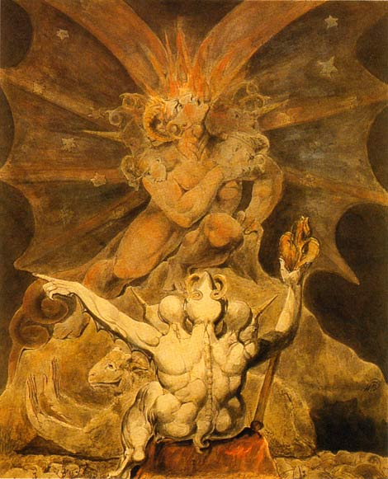
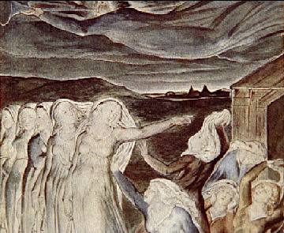
As An Artist
The Number of the Beast is 666

Slide 9
SONGS OF EXPERIENCE
Darker pictures
Clawed hands
People suffering and agonizing faces
Shows the BAD or DARK side of people

Slide 10
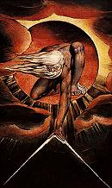
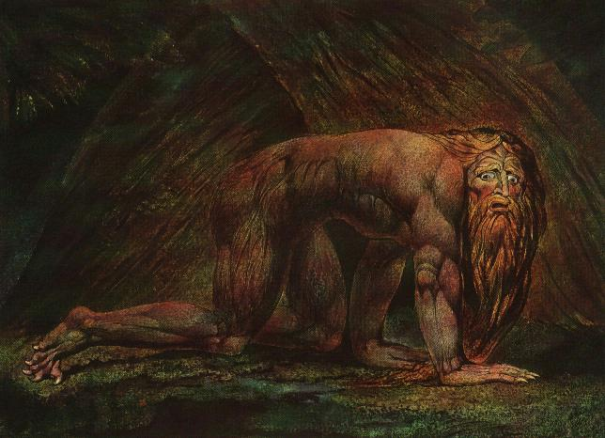
Nebuchadnezzar
The Ancient of Days

Slide 11
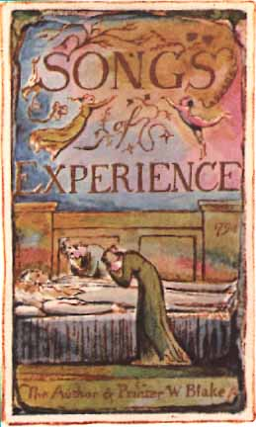
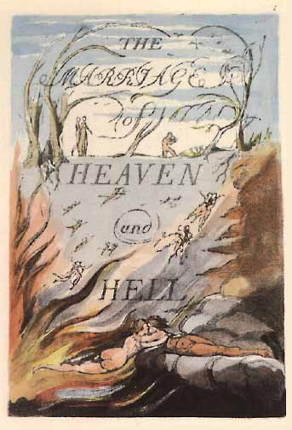
The two poems that he did –
Songs of experience and the marriage of heaven and hell.

Slide 12
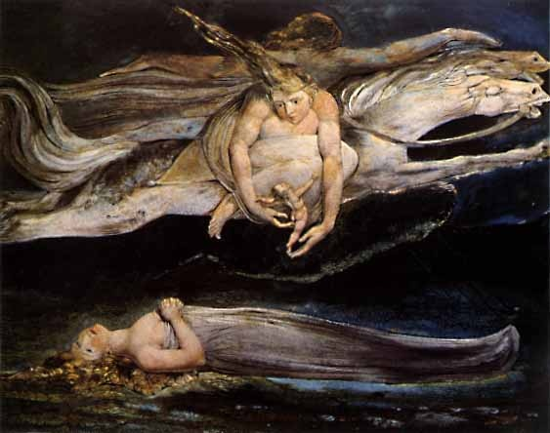
"I do not behold the outward creation... it is a hindrance and not action.”
This is why he only stuck to this subject manner and thought himself to be a religious man.

Slide 13
Romantic Ideals
Fascination with the EXOTIC
MYSTIC AND TRANSCENDENT

Slide 14
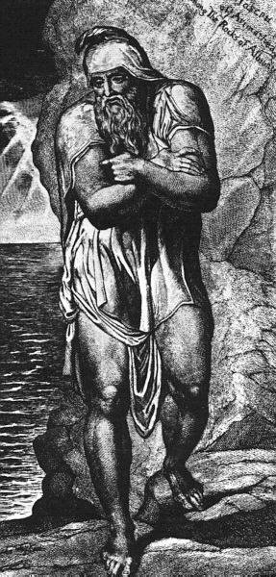
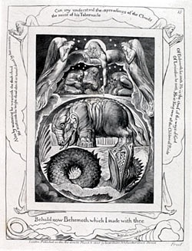
Joseph of Arimathea Among the Rocks of Albion

Slide 15
Blake illustrated the book of Job as seen here. He also was have said to have conversed with angel and prophet s of the old testament.
One of the Prophets he conversed with was Ezekiel .

Slide 16
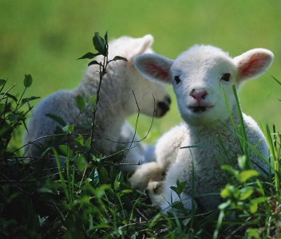
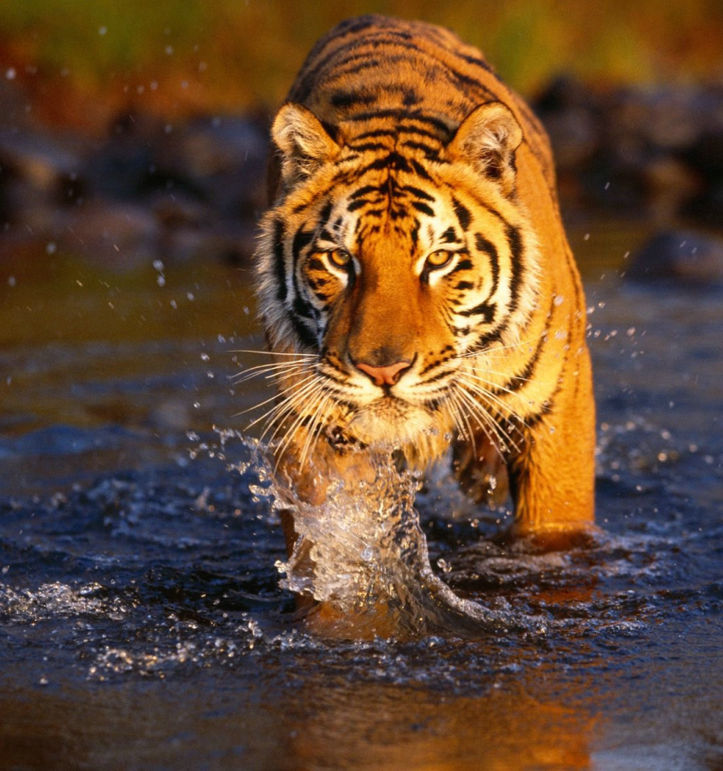
Jesus Christ
Fiery beast of Hell

Slide 17
The Lamb and The Tyger Poems
The Lamb is gentle, good, childlike and innocent
The lamb illustrated and symbolized Jesus Christ.
The fire in The Tyger represented hell.
Alliteration is used to sound like the tyger is stalking.

Slide 18
Learning Style VISUAL SPATIAL
They enjoy looking at maps, charts, pics, videos, and movies.
SKILLS- creating something from NOTHING, manipulating images, designing, and interpreting visual images.
CAREERS- artists, engineers, inventors, interior designers, and architects.

Slide 19
Activity
Draw the images that comes to your to mind as we read the lamb and the tyger.

